Slide 1
What to present at LHCb week Calibtration & Alignment
07/03/2016 Claire Prouve - University of Bristol
on behalf of the Alignment & Calibration group

Slide 2
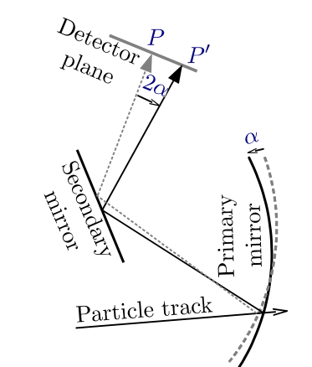
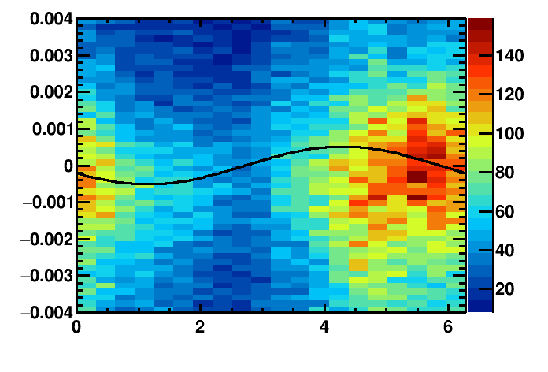
Magnification coefficients
Magnification coefficients: translate the misalignment-on-the-detector-plane into individual mirror misalignments
Previously calculated for every alignment for each iteration on data ➔ reconstruct all events and fit all histograms 8 additional times.
Now pre-calculated and used same set for all alignments and all iterations.
➔ No significant difference in resulting mirror tilts and procedure 9 times faster!!!
What we measure directly from the histograms.
Δθ / rad
azimuthal angle/ rad
Individual mirror misalignments.

Slide 3
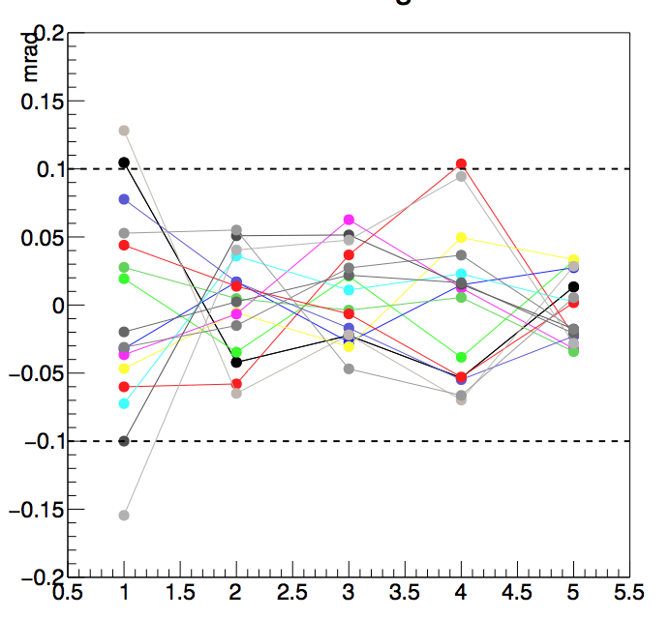
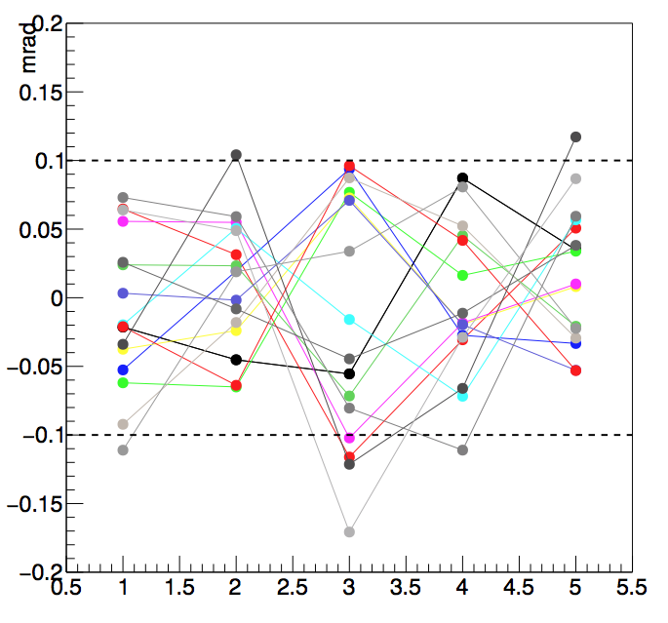
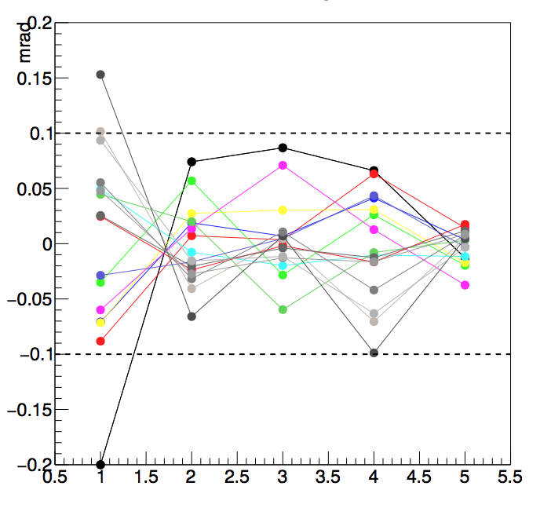
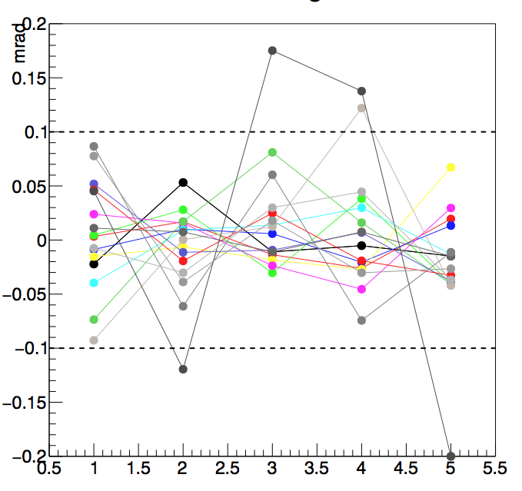
Rich Alignment
Stability study: how many events do we need?
Made several alignments on different runs of the same time-period.
One set of 5 alignments on ~0.7M events
One set of 5 alignments on ~1.5M events
Plot the difference of the resulting mirror tilt from the average value for each mirror and each alignment
➔ No great improvement with greater number of events
➔ 1M events for RICH1
Rich1 Y-Tilts 0.7M events
Rich1 Y-Tilts 1.5M events
Mirror-tilt – (average mirror tilt)
Each color represents one mirror.
Mirror-tilt – (average mirror tilt)
Alignment
Alignment
Rich1 Z-Tilts 0.7M events
Rich1 Z-Tilts 1.5M events
Conver-gence if all tilts < 0.1mrad
Mirror-tilt – (average mirror tilt)
Mirror-tilt – (average mirror tilt)
Alignment
Alignment

Slide 4
Rich Alignment
Stability study: how many events do we need?
Made several alignments on different runs of the same time-period.
One set of 5 alignments on ~0.7M events
One set of 5 alignments on ~1.5M events
Plot the difference of the resulting mirror tilt from the average value for each mirror and each alignment
➔ No great improvement with greater number of events
➔ 1M events for RICH1

Slide 5
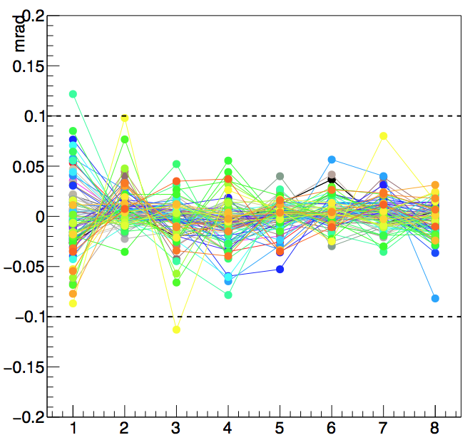
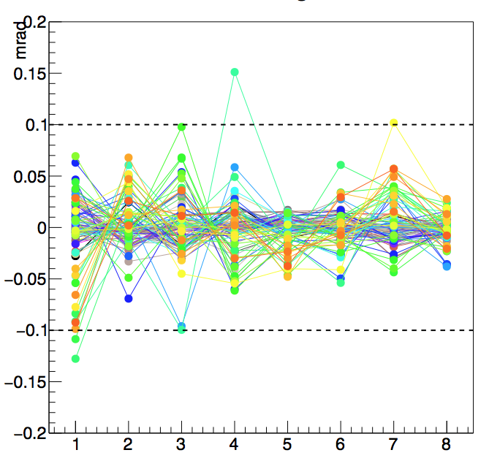
Rich Alignment
Stability study: how many events do we need?
Rich2 Y-Tilts 1.7M events
Made several alignments on different runs of the same time-period.
One set of 8 alignments on ~1.7M events
Plot the difference of the resulting mirror tilt from the average value for each mirror and each alignment
Variations in alignment constants below convergence criteria
➔ 2M events for RICH2
Mirror-tilt – (average mirror tilt)
Each color represents one mirror.
Alignment
Rich2 Z-Tilts 1.7M events
Mirror-tilt – (average mirror tilt)
Convergence if all tilts< 0.1mrad
Alignment

Slide 6
Rich Alignment
Magnet polarity: do the alignment constants need updating after flip of magnet polarity?

